Slide 1
UNIT 3: Introduction to Enterprise Application architectures & Application Architecture Patterns
BY: SIMRAN S

Slide 2
Layer Architecture
Most common architecture pattern
Otherwise known as the n-tier architecture pattern.
Closely matches the traditional it communication and organizational structures found in most companies

Slide 3
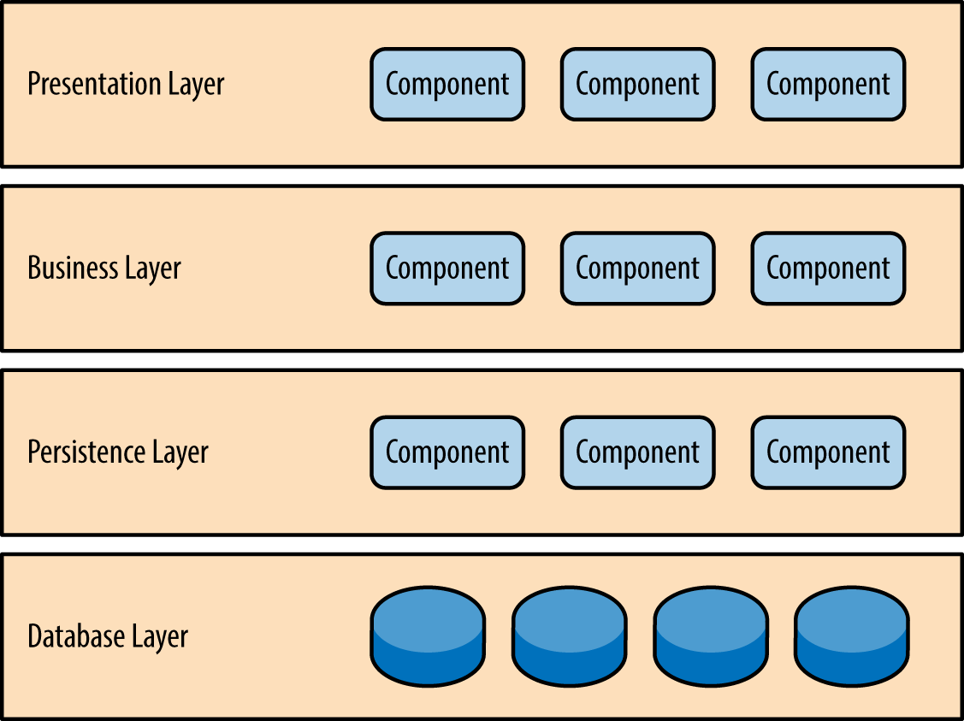
Pattern Description
Presentation layer would be responsible for handling all user interface and browser communication logic.
Business layer would be responsible for executing specific business rules associated with the request.
The persistence layer, also called the data access layer, acts as a protective layer. It contains the code that's necessary to access the database layer. This layer also holds the set of codes that allow you to manipulate various aspects of the database.
Database layer is responsible for handling data, databases.

Slide 4
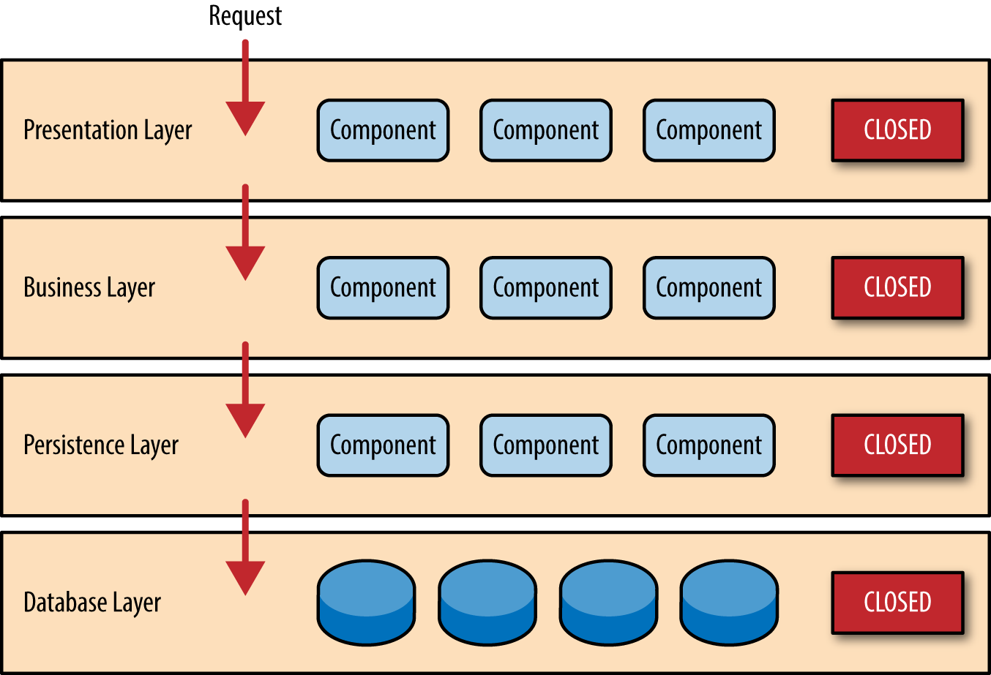
layers of isolation
Closed layers and request access
Layers are independent of each others.
Very tightly coupled application
Very hard and expensive to change.

Slide 5
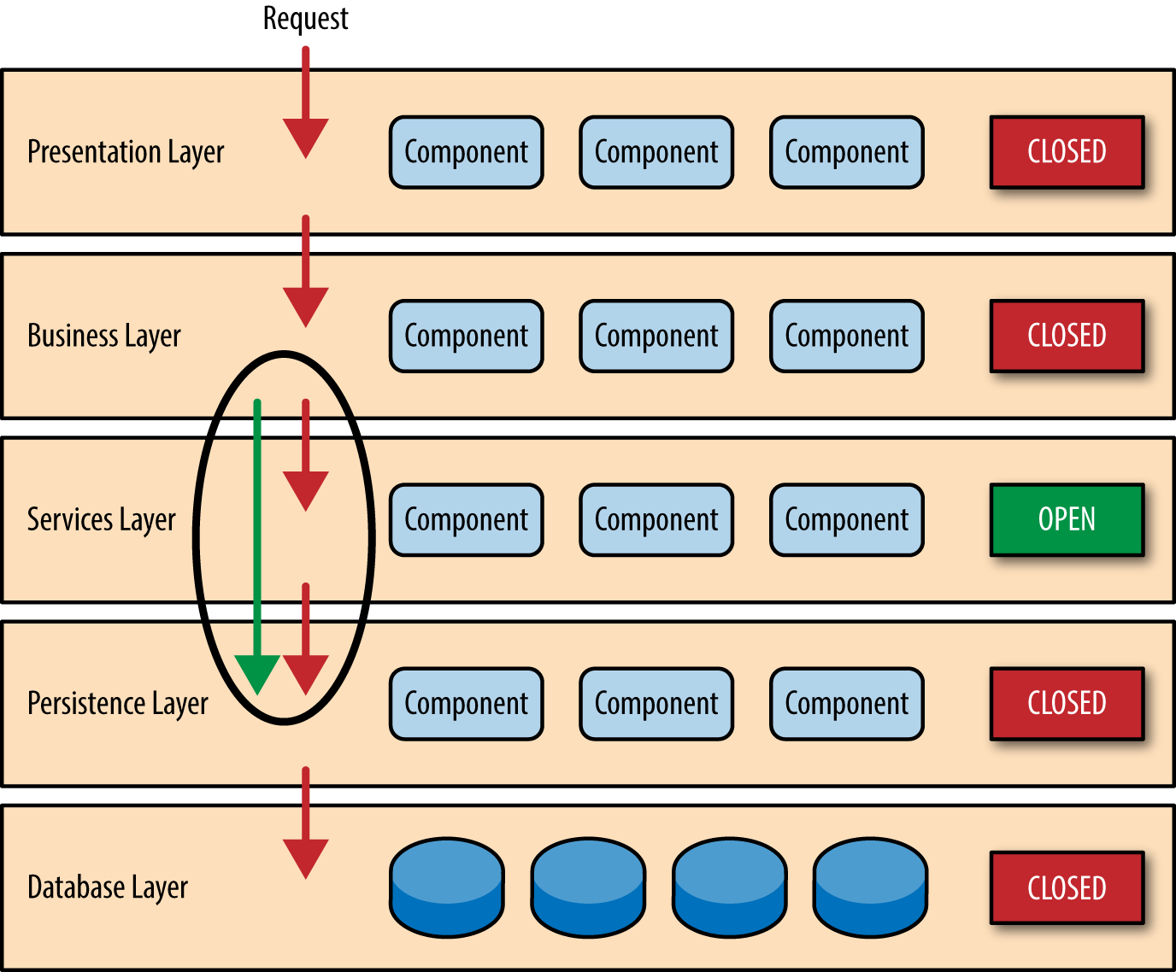
Open layers and request flow
Helps define the relationship between architecture layers and request flows
Also provides designers and developers with the necessary information

Slide 6
Event driven Architecture
Event-driven architecture (EDA) is a design paradigm in which a software component executes in response to receiving one or more event notifications.
What is it?
Business Event
ALERT OF STATE CHANGE
SYSTEM

Slide 7
Benefits of Eda
SCALABLE
EASY TO CHANGE
DOES NOT DISTURBS OTHER PARTS OF THE SYSTEMS WHILE CHANGING THE STATE (LOOSELY COUPLED IN NATURE)

Slide 8
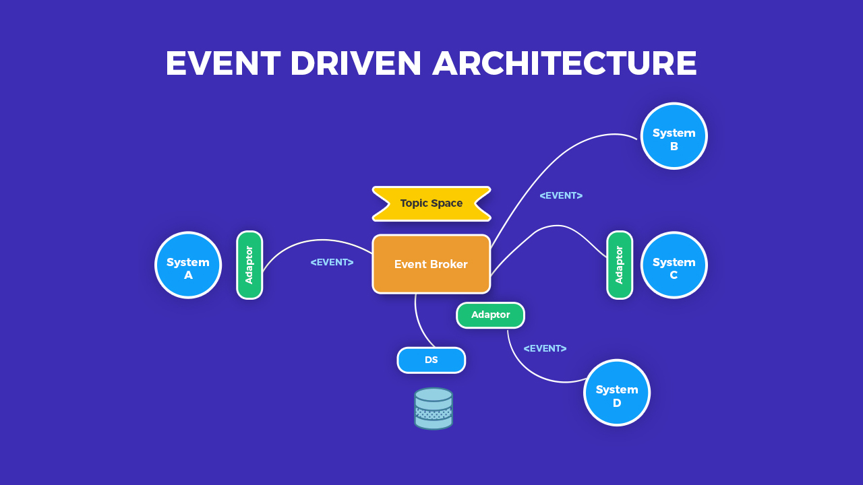
An event broker is middleware that mediates the communication of event messages between producers and consumers using the various message exchange patterns.

Slide 9
Service oriented Architecture
Service-Oriented Architecture built applications based on services and loosely-coupled architecture. So they can be reused.

Slide 10
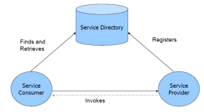
Service providers are the parties who build service and make available service.
Service consumers are the clients who consume services.
Service directory is the place where service providers register the services and consumer search for services

Slide 11
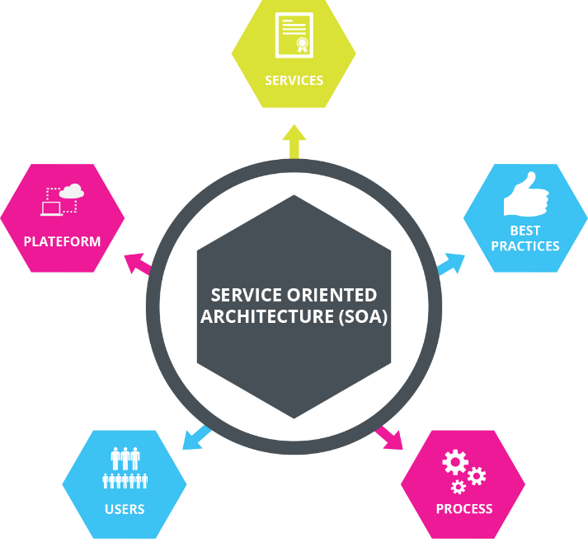

Slide 12
Micro-service
It modularizing complex applications into distributed parts that run parallel without any harm to another part of the applications.

Slide 13
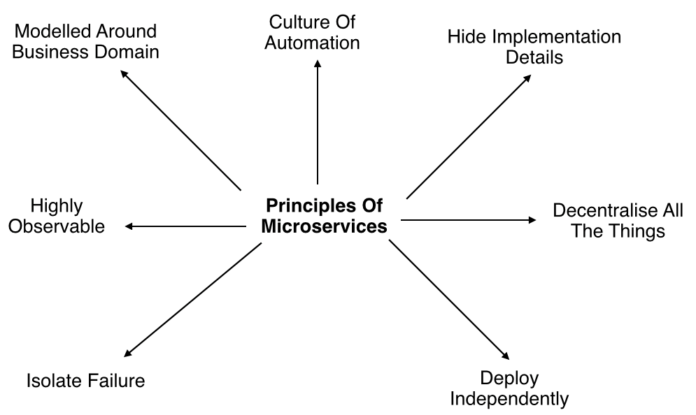
Principles of micro-service

Slide 14
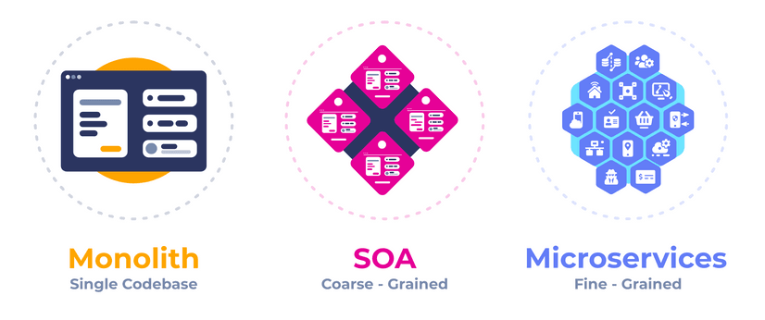

Slide 15
Plug-in architecture Layering
Allows third-party developers to add functionality to an application without having access to the source code.

Slide 16
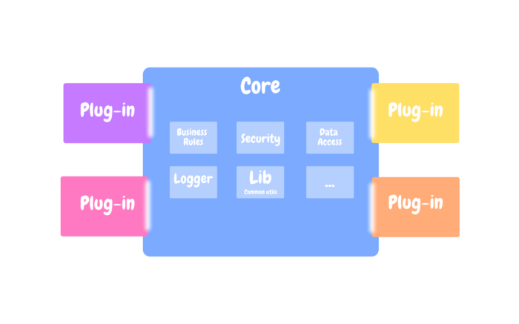
Core system
At a high level, it defines how the system operates and the basic business logic. There is no specific implementation, no customization. It is abstracted.
Plug-ins
The plug-ins are stand-alone, independent components that contain specialized processing, additional features, and custom code that is meant to enhance or extend the core system to produce additional capabilities.

Slide 17
Mapping to database
Data mapping is the process of matching fields from one database to another. It's the first step to facilitate data migration, data integration, and other data management tasks.

Slide 18
Data migration
Data migration is the process of moving data from one system to another as a one-time event.
Data integration
Data integration is an ongoing process of regularly moving data from one system to another.
Data transformation
Data transformation is the process of converting data from a source format to a destination format.
Data warehousing
If the goal is to pool data into one source for analysis or other tasks, it is generally pooled in a data warehouse.

Slide 19
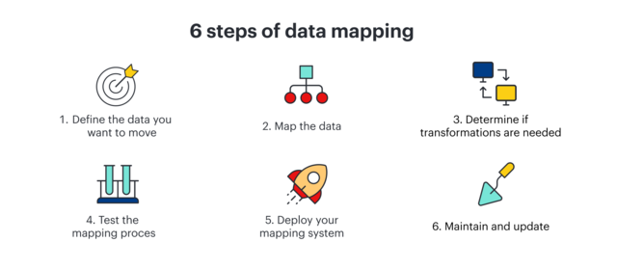

Slide 20
Web Presentation
Enterprise Web Applications allow you to manage and record the internal and external operations and processes of your company or organization.

Slide 21
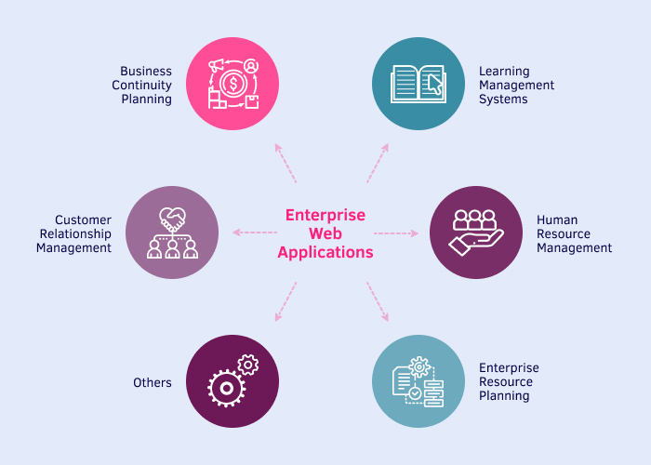

Slide 22
Concurrency & Organising Domain Logic
Concurrency is also synonymous with boundary-less organization as it has been demonstrated with concurrent engineering implementation that broken down barriers between disciplines enable collaboration.
By organizing functionalities in a logical and structured way, it will be easier for developers to understand how the system works and make changes to it as needed.

Slide 23

Thank You!

